Slide 1
AirKitchen:
Week6 Update
Team FoodXYZ
Mengdan Yuan, Wen Xin

Slide 2


Slide 3
Feature Engineering 2
More useful features!!!
1. Active days: number of days user place orders
3. accountLength: how long account has been active
4. avg, min, max time between two orders
5. How long it has been since last time user placed an order
6.the day of last order, whether use coupon, send type and distance..
….. 44 aggregated features
….

Slide 4
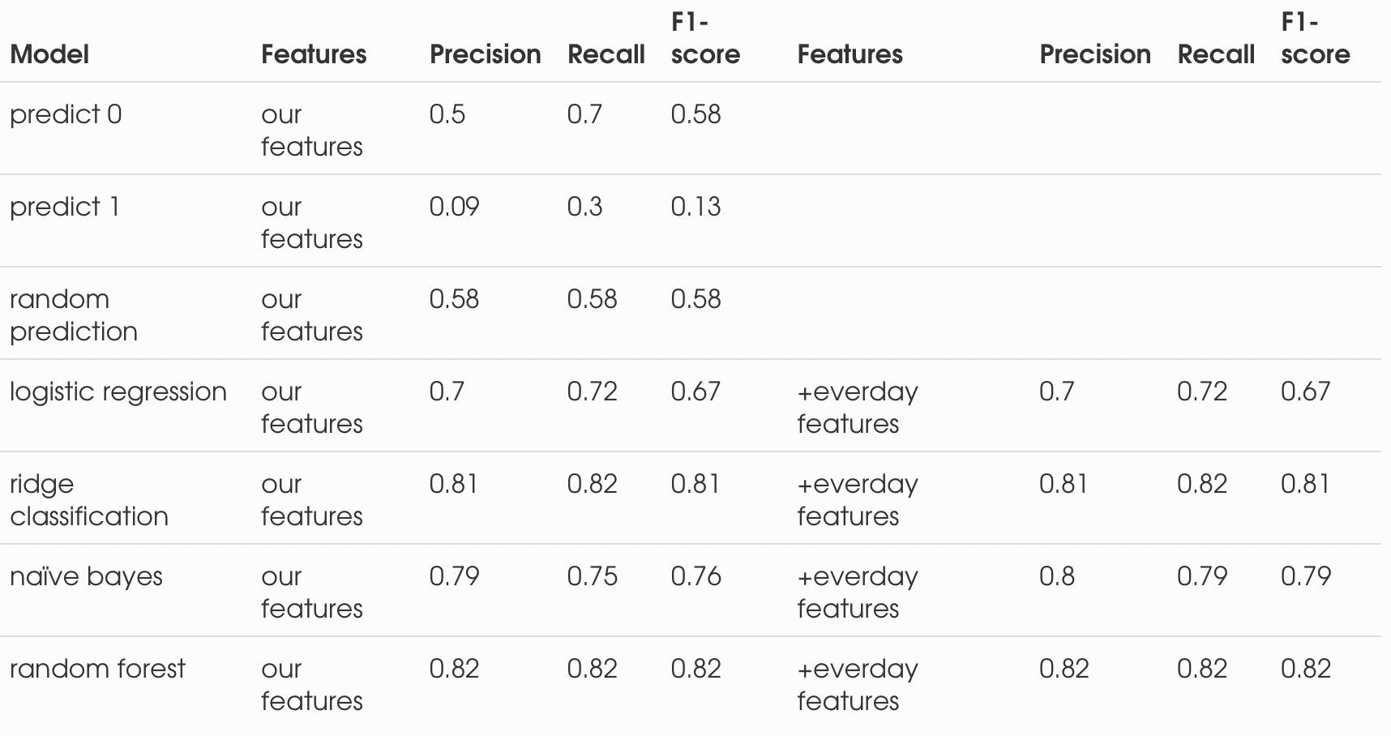
Baseline Models

Slide 5
Next Steps
Build and evaluate the model: lightgbm
Outliers detections
Keep research existing methods of user retention prediction
Add more features
Notes:
Whether your customers are people or businesses, and no matter if you're selling products or services, the problem is still the same: Keeping current customers while continuing to grow with new ones. This means understanding who is no longer a buyer and why they've chosen to leave. Once you have the answers, you can work on your retention practices to prevent similar losses in the future.
If the prediction matches the actual status of the customer, then there is no action necessary. However, if an active customer is predicted to be a churned customer, this will imply that this customer is at-risk of churning. Alternatively, if a customer is currently inactive (meaning that they previously churned), but the prediction is that they are an active customer, this may indicate that they are a good target with which to attempt to reinstate business.

